Slide 1
ATAI
Advanced Techniqueof Artificial Intelligence
ATAI
ChongqingUniversity _{AdvancedTechniqueof}
of Technology Artificial Intelligence
Chongqing University of
Technology
Chongqing University ^{ATAI}
_{of Technology} Advanced Techniqueof
Artificial Intelligence
Chongqing University of Technology
Chongqing University of Technology
A Multi-Focus-Driven Multi-Branch Network for
Robust Multimodal Sentiment Analysis
Code:https://github.com/MFMB-Net/MFMB-Net
2025.6.12 •ChongQing
—— AAAI 2025
Reported by YaoChen Li
1

Slide 2
ATAI
AdvancedTechniqueof
Artificial Intelligence
ATAI
ChongqingUniversity _{AdvancedTechniqueof}
of Technology Artificial Intelligence
ChongqingUniversity of Technology
Motivation
1) Most of existing approaches focus primarily on designing feature reconstruction strategies independently, neglecting the crucial issue of synergistically integrating reconstruction and fusion strategies.
2)Current mainstream methods often use transformer for simple modality fusion, only focusing on global features and struggling to capture important local detail cues.

Slide 3
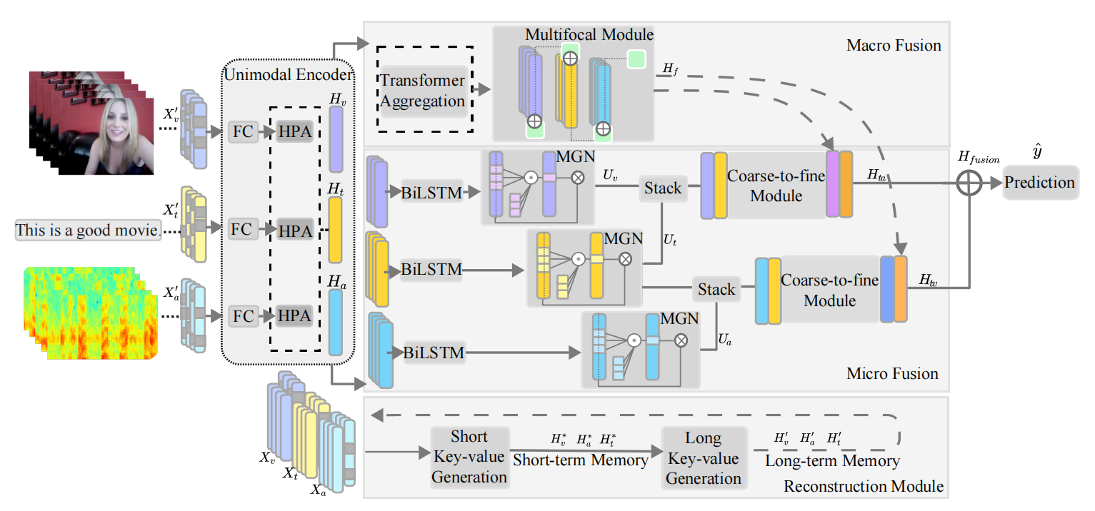
ChongqingUniversity of Technology
ATAI
AdvancedTechniqueof
Artificial Intelligence
ATAI
ChongqingUniversity _{AdvancedTechniqueof}
of Technology Artificial Intelligence
Overview

Slide 4
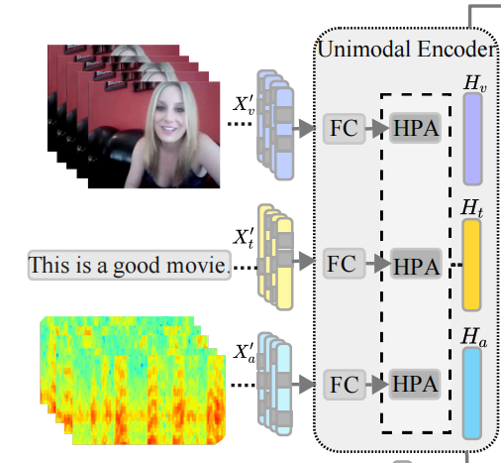
ChongqingUniversity of Technology
ATAI
AdvancedTechniqueof
Artificial Intelligence
ATAI
ChongqingUniversity _{AdvancedTechniqueof}
of Technology Artificial Intelligence
Method

Slide 5
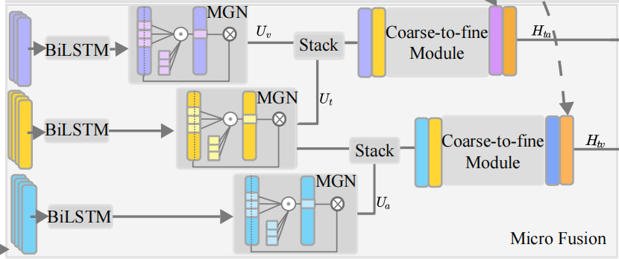
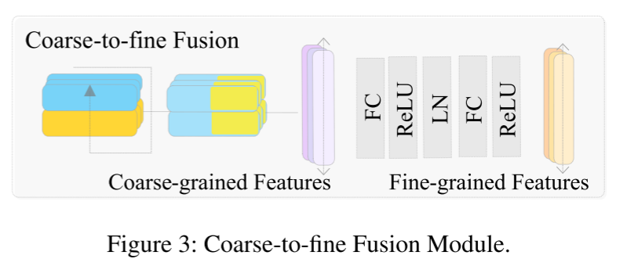
ChongqingUniversity of Technology
ATAI
AdvancedTechniqueof
Artificial Intelligence
ATAI
ChongqingUniversity _{AdvancedTechniqueof}
of Technology Artificial Intelligence
Method

Slide 6
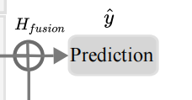
ChongqingUniversity of Technology
ATAI
AdvancedTechniqueof
Artificial Intelligence
ATAI
ChongqingUniversity _{AdvancedTechniqueof}
of Technology Artificial Intelligence
Method

Slide 7
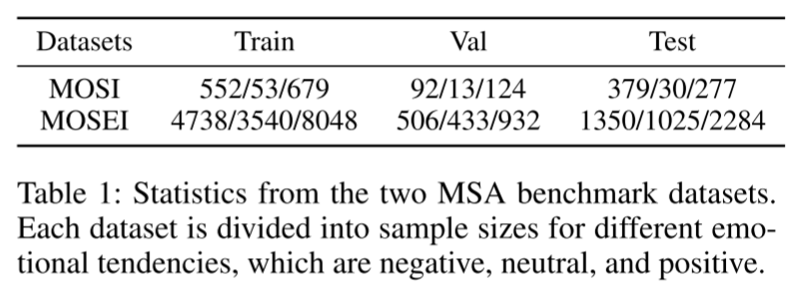
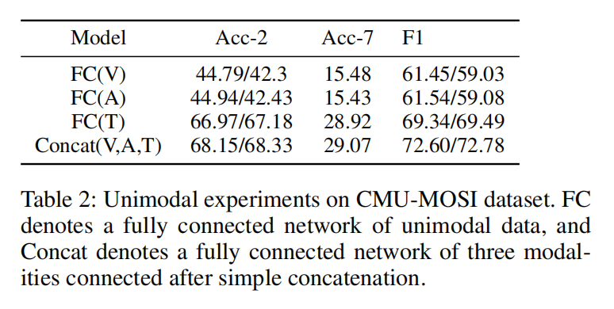
ATAI
AdvancedTechniqueof
Artificial Intelligence
ATAI
ChongqingUniversity _{AdvancedTechniqueof}
of Technology Artificial Intelligence
ChongqingUniversity of Technology
Experiments

Slide 8
ATAI
AdvancedTechniqueof
Artificial Intelligence
ATAI
ChongqingUniversity _{AdvancedTechniqueof}
of Technology Artificial Intelligence
ChongqingUniversity of Technology
Experiments

Slide 9
ChongqingUniversity of Technology
ATAI
AdvancedTechniqueof
Artificial Intelligence
ATAI
ChongqingUniversity _{AdvancedTechniqueof}
of Technology Artificial Intelligence
Experiments

Slide 10
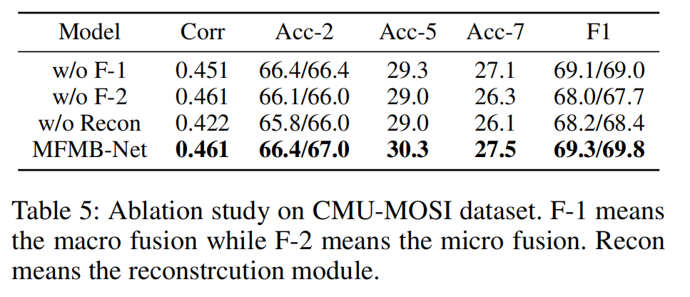
ChongqingUniversity of Technology
ATAI
AdvancedTechniqueof
Artificial Intelligence
ATAI
ChongqingUniversity _{AdvancedTechniqueof}
of Technology Artificial Intelligence
Experiments

Slide 11
ChongqingUniversity of Technology
ATAI
AdvancedTechniqueof
Artificial Intelligence
ATAI
ChongqingUniversity _{AdvancedTechniqueof}
of Technology Artificial Intelligence
Thanks!

